Slide 1
SmartV
Pritom Rajkhowa

Slide 2
SMART CONTRACT AUDIT PRICING
Company | Methodology + Timeline | Cost
CyStack [Vietnam] https://cystack.net/services/smart-contract-audit | Manual audit + automated tools Timeline : 1 month | ~ 5,000 USD
Certik [USA] | Manual audit + automated tools Timeline : 200-500 lines of code : 1 week => 1 round with the report and recommendation Additional round : need to pay extra | Start at ~20,000 USD 5,000 USD / day
Token Guard https://tokenguard.io/blog/smart-contract-audit | Manual audit + automated tools | Start at ~ 2,499 USD (Basic code verification per contract)
Free Lance From Upwork platform | Manual and Automated Code Review | 250 USD code less than 200 lines 350 USD code less than 500 lines 500 USD code less than 1000 lines
General Consensus from general market screening articles | It all depends on the size and complexity of your smart contract and the level of detail the smart contract auditing company uses when performing the audit | ~ $5,000 - $30,000 USD (simple token, small-medium projects) Enterprise blockchain projects : >70,000 USD
Company | Methodology + Timeline | Cost
SlowMist [China] | Manual audit + automated tools Timeline : 2 weeks for initial round audit | ~ 10,000 USD
Consensys [USA] | Automated Fuzzing Tool https://consensys.net/diligence/ - Need to add the annotations into the code => Time consuming | Developer package : 500h / month (~7,000 USD) : pay upfront
Consensys [USA] | Personalised audit session - 2 auditors - Deep dive analysis - 2 weeks process + 1 week fixing / re-check | ~120,000 USD
MythX Consensys [USA] https://mythx.io/ | Fully automated tool No consulting session to explain the report | 9.99 USD/Month [$3.33/scan] 49 USD/Month. [$0.10/scan] 249 USD/Month. [$0.03/scan]
Solidity Finance [USA] https://solidity.finance/ | Manual audit + automated tools TimeLine ~ 1 month | 12,000 USD - 15,000 USD
SECBIT [China] https://secbit.io | Manual audit + automated tools TimeLine: 1.5-3weeks : first round Final Audit round | 20,000 - 50,000 USD

Slide 3
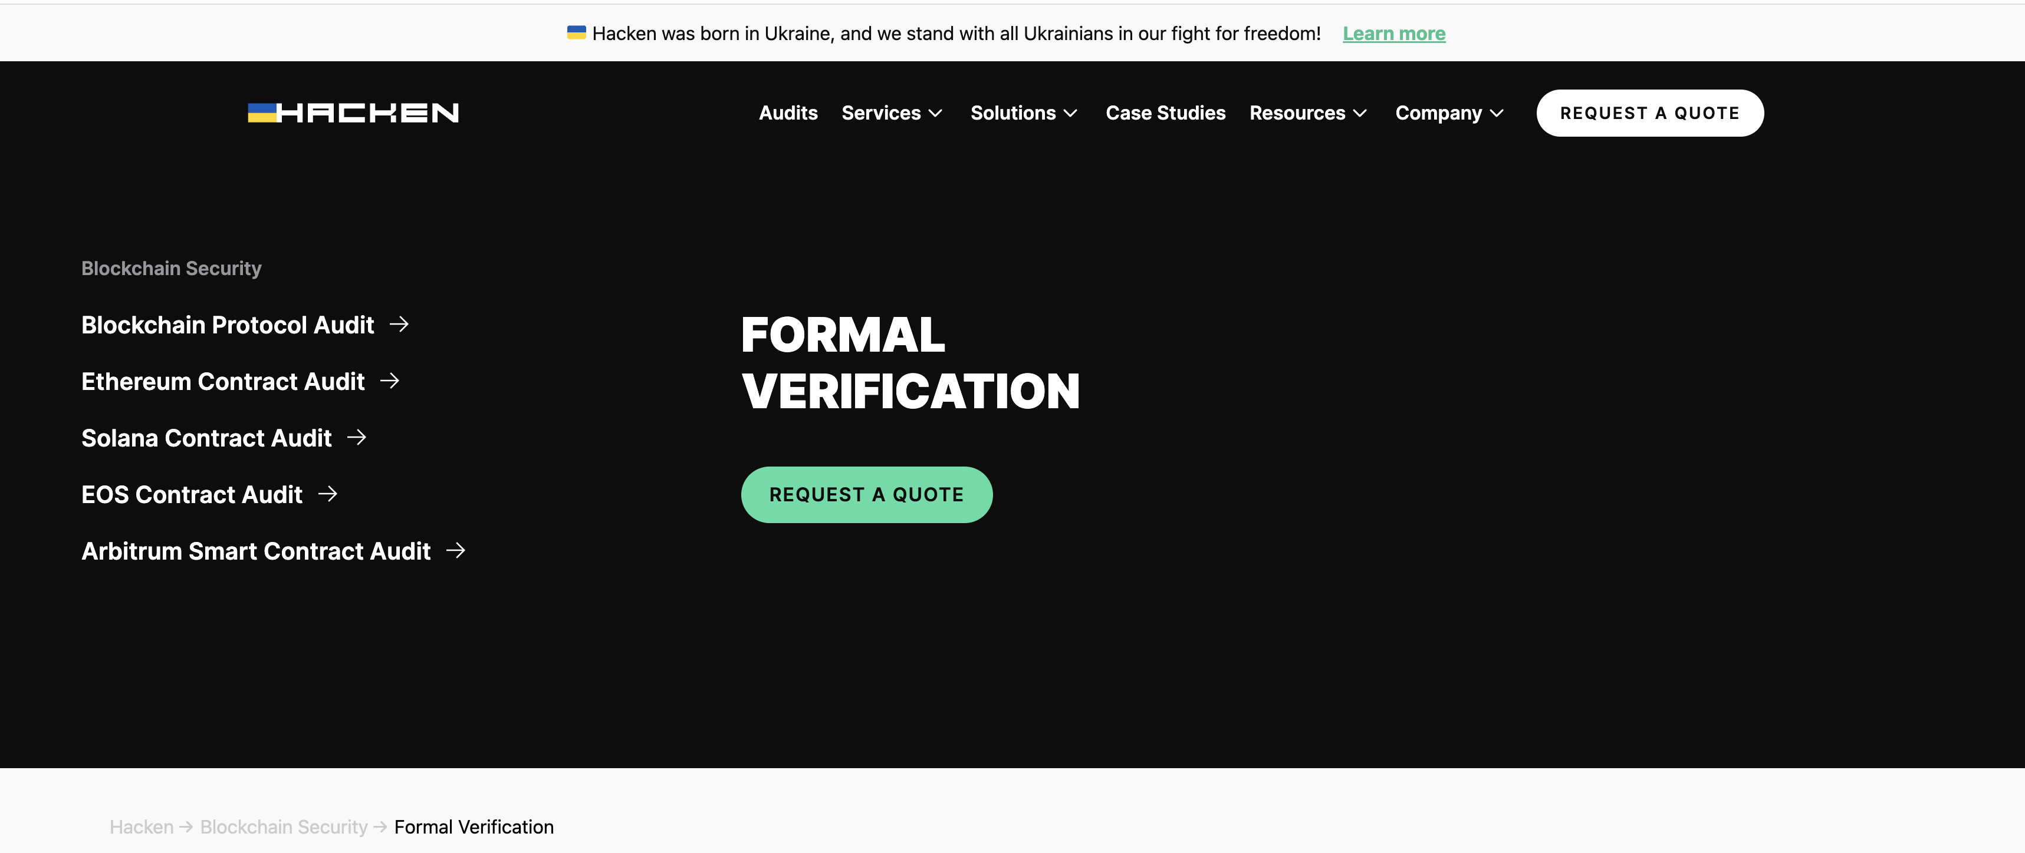
Formal Verification

Slide 4


Slide 5

Major Gap, We want to fill
Although currently the number of blockchain based applications is growing exponentially, commercially only one option is available for smart contract verification which is the heart of blockchain based applications. There is a great potential to be explored in this market.
MythX automatically scans for security vulnerabilities in Ethereum and other EVM-based blockchain smart contracts

Slide 6
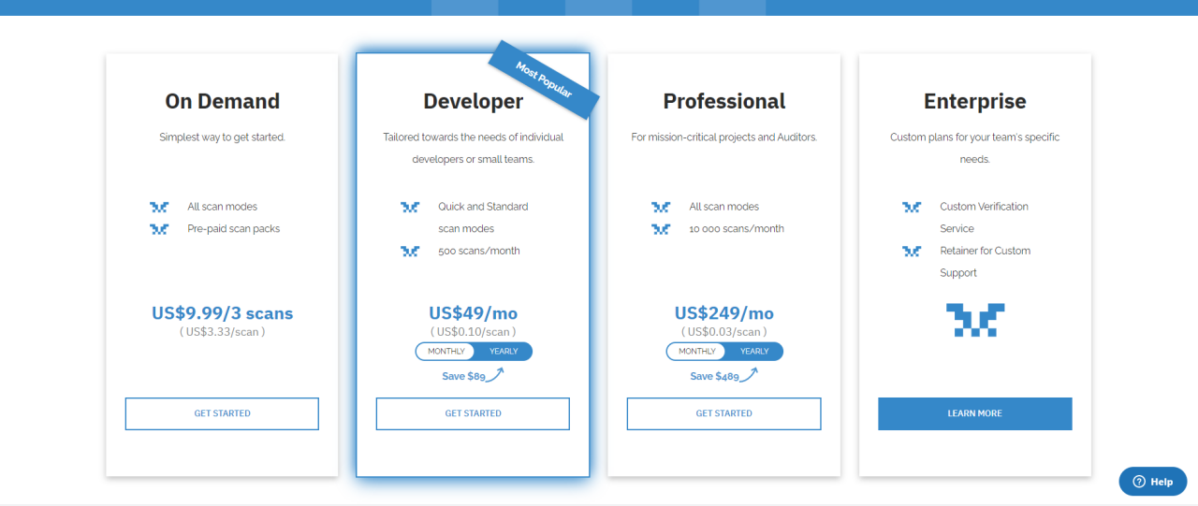
MythX Pricing Scheme

Slide 7
SmartV : Automated smart Contract auditing System
Motivation:
Fully Automated Process
Less False Positive
Inter Procedural Bugs
Financial Support :
University Grants Committee Industry Interface
Bridge Gap Fund (BGF) project (BGF.025.2021)

Slide 8
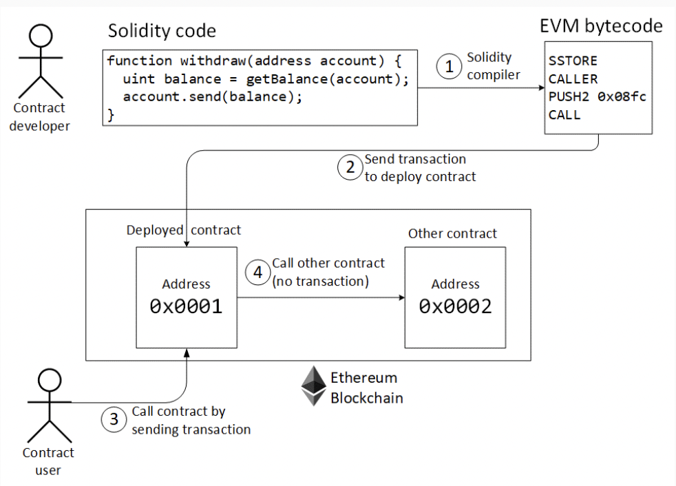
Ethereum Smart Contracts
Programs deployed on the Ethereum blockchain
Usually written in Solidity, compiled into EVM bytecode
Can transfer money to other addresses (including contracts)
Each instruction execution consumes gas

Slide 9

The BECToken
contract BecTokenSimplified {
using SafeMath for uint256;
uint256 public totalSupply;
mapping(address => uint256) balances;
constructor() {
totalSupply = 7000000000 * (10**18);
balances[msg.sender] = totalSupply;
}
function batchTransfer(address[] receivers, uint256 value) returns (bool) {
uint256 amount = receivers.length * value;
require(value > 0 && balances[msg.sender] >= amount);
balances[msg.sender] = balances[msg.sender].sub(amount);
for (uint i = 0; i < receivers.length; i++) {
balances[receivers[i]] = balances[receivers[i]].add(value);
}
return true;
}
}
Total tokens
Balance of each user
Initialization
Creator gets 7x10²⁷
Batch transfer value to N receivers
Total amount = value x N
Reduce sender balance by total
Increase receiver balances by value N times

Slide 10
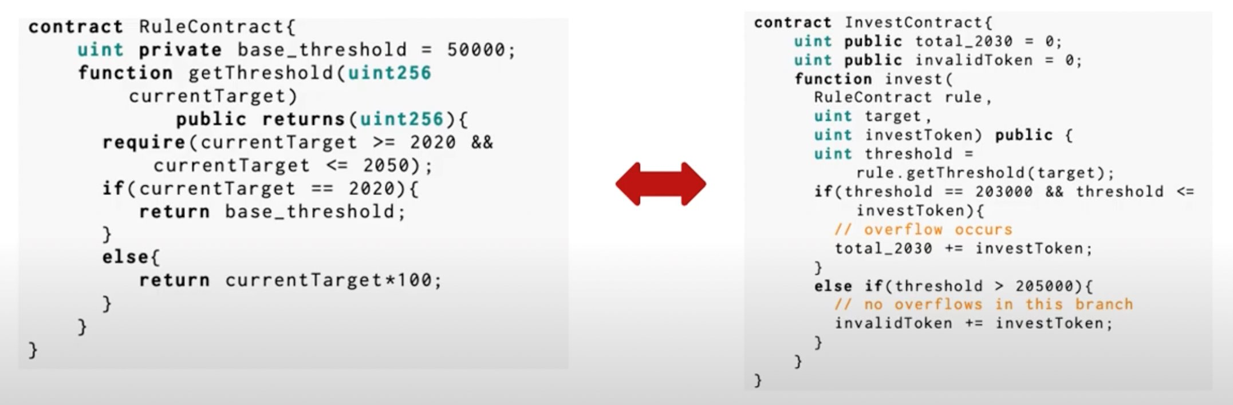
Inter Procedural Bugs

Slide 11
Property verification process
correction
formalization
Formal
model in form of
verification
Report
Program
body
Model
verdict
Source Code
Behavior
properties
System can be presented with requirements,
source program code

Slide 12
Goal of the work
Source system
representation
Behavior formal
model in form of
formalization
Source Code+EVM
semi-automatic
Security
properties
Source Code+EVM
automatic
Security
properties
Source Code+EVM
manual
Security
properties
Problem: high efforts for manual formalization of source code
Goal: reduce manual efforts through automation

Slide 13
Benchmarking of SmartV

Slide 14
WETH white hat attack – June 10, 2016 |
The DAO attack – June 17, 2016 |
SpankChain attack – October 9, 2018 |
imBTC Uniswap pool attack – April 18, 2020 |
Lendf.Me attack – April 19, 2020 |
Akropolis attack – November 12, 2020 |
ValueDeFi attack – May 7, 2021 |
Rari Capital attack – May 8, 2021 |
BurgerSwap attack – May 27, 2021 |
Iron Finance attack – June 16, 2021 |
PolyDEX attack – June 20, 2021 |
DeFiPie attack – July 12, 2021 |
Sanshu Inu attack – July 20, 2021 |
XSURGE attack – August 16, 2021 |
C.R.E.A.M. Finance attack – August 30, 2021 |
Siren Protocol attack – September 3, 2021 |
CreatureToadz attack – October 21, 2021 |
Grim Finance attack – December 18, 2021 |
Visor Finance attack – December 21, 2021 |
HypeBears attack – February 3, 2022 |
Bacon Protocol attack – March 5, 2022 |
Paraluni attack – March 13, 2022 |
Hundred Finance attack – March 15, 2022 |
Agave Finance attack – March 15, 2022 |
Revest Finance attack – March 27, 2022 |
Voltage Finance attack – March 31, 2022 |
BNB Brokers attack – April 27, 2022 |
Fei Protocol attack – April 30, 2022 |
Bistroo attack – May 7, 2022 |
Ownly attack – May 10, 2022 |
Omni attack – July 10, 2022 |
Thunder Brawl attack – September 30, 2022 |
QuickSwap Lend attack – October 23, 2022 |
n00dleSwap attack – October 25, 2022 |
DFX Finance attack – November 10, 2022 |

Slide 15



SmartV Feature Comparison
Features | SmartV | MythX
Re-Entrancy(RE)
Unhandled Exceptions (UE)
Locked Ether (LE)
Transaction Order Dependency (TO)
Integer Overflow (IO)
Unrestricted Action (UA)
User added Assertion(AS)
Average Time | 10 x T | T
False Positive

Slide 16
SmartV–OP: EVM optimization

Slide 17
A framework to optimizes Smart Contract
It tries to find a sequence of EVM instructions produces the same stack as the original block, but consumes a smaller amount of gas.
1 PUSH1 0x04 1 PUSH1 0x4
2 PUSH1 0x04 2 DUP2
3 PUSH1 0x04 3 DUP2
4 POP 4 ADD
5 POP Estimated new cost: 12
6 DUP1
7 DUP3
8 ADD
Estimated initial cost: 22

Slide 18
Bytecodes 0 to 47 of Welfare
1 PUSH1 80 9 DUP2 17 DUP4 25 PUSH2 3E8 33 PUSH2 FFFF 41 MUL
2 PUSH1 40 10 SLOAD 18 PUSH2 FFFF 26 PUSH1 1 34 MUL 42 OR
3 MSTORE 11 DUP2 19 AND 27 PUSH1 16 35 NOT 43 SWAP1
4 PUSH1 64 12 PUSH2 FFFF 20 MUL 28 PUSH2 100 36 AND 44 SSTORE
5 PUSH1 1 13 MUL 21 OR 29 EXP 37 SWAP1 45 POP
6 PUSH1 14 14 NOT 22 SWAP1 30 DUP2 38 DUP4 46 CALLVALUE
7 PUSH2 100 15 AND 23 SSTORE 31 SLOAD 39 PUSH2 FFFF 47 DUP1
8 EXP 16 SWAP1 24 POP 32 DUP2 40 AND 48 ISZERO

Slide 19
Symbolic Execution
STACK = [ISZERO(CALLVALUE), CALLVALUE],
MEMORY = [MSTORE(64,128)],
STORAGE = [SLOAD1(1), SSTORE(1,V1), SLOAD2(1), SSTORE(1,V2)]
Where
V1 = OR(MUL(...)),AND(NOT(..)), SLOAD1(1)) and
V2 is another similar expression involving arithmetic, binary operations and SLOAD2(1).

Slide 20
All accesses operate on the same location
conf(SLOAD1(1),SSTORE(1,V1)),
conf (SLOAD1(1),SSTORE(1,V2)),
conf(SLOAD2(1),SSTORE(1,V1)),
conf(SLOAD2(1),SSTORE(1, V2))
conf(SSTORE(1,V1,SSTORE(1,V2))

Slide 21
To SLOAD2(1), as the previous SSTORE instruction has stored the value V1 at the same location and there are no other storage instructions with conflict between them. Hence, we eliminate it from Storage and replace it by V1.
On the two SSTORE instructions as they store a value at the same position without conflict loads in between. Then, we remove SSTORE(1,V1) from Storage.
The resulting SMS has the same Stack and Memory and Storage is now [SLOAD1(1), SSTORE(1,V2’)] where V2’ is V2 replacing SLOAD2(1) by V1.

Slide 22
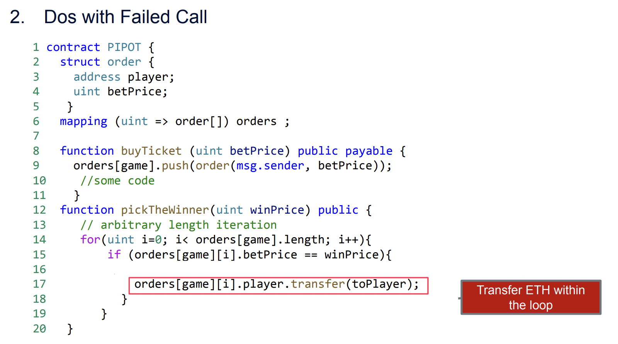
Gas-related vulnerabilities
Notes:
Also we have the external call transfer is executed within the loop body so if the attacker can make themselves a target for this external call they can actually force this loop to run out of gases and kill just by increasing the gas cost of the code executed on the target side of the external code transfer for the related work on detecting gas-related vulnerabilities.

Slide 23
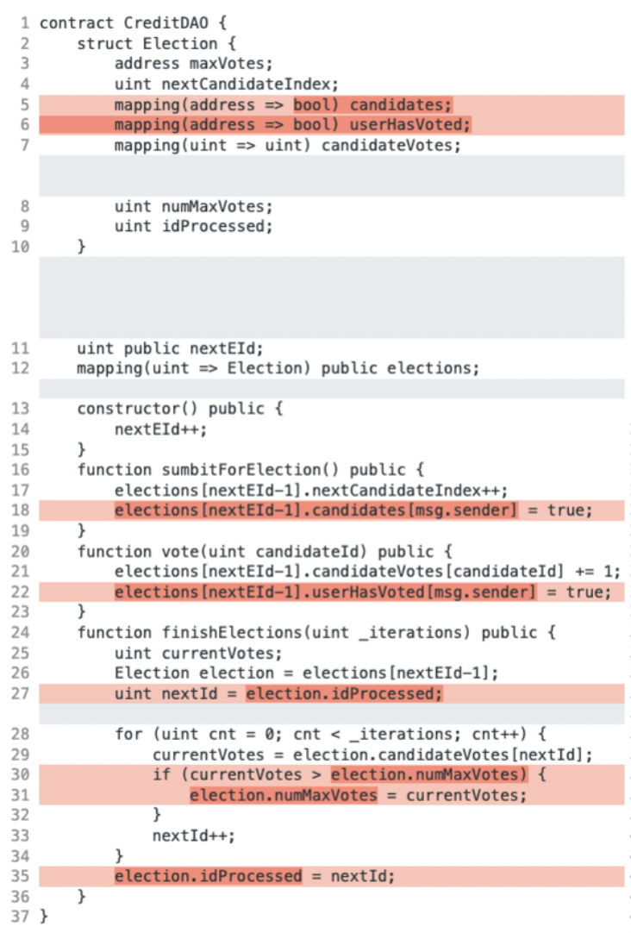
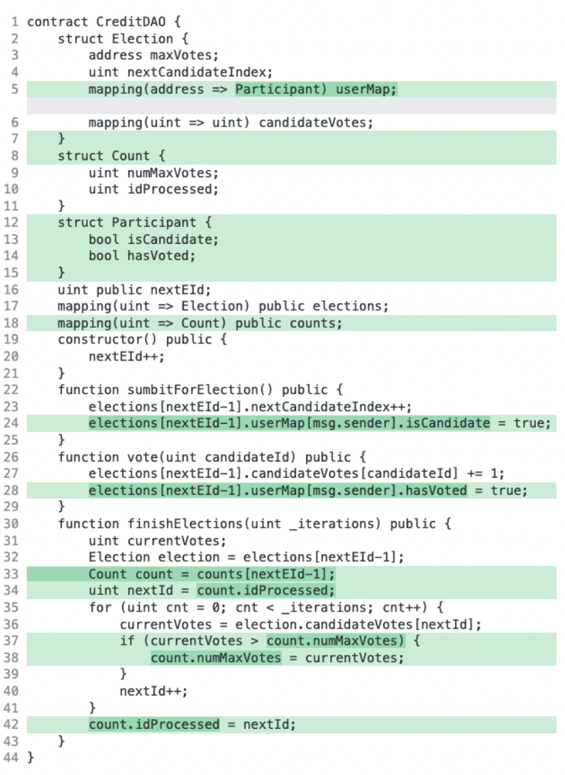
Gas-related Optimization Code
Notes:
A motivating example to demonstrate our approach. The smart contract is adapted from the CreditDAO contract from Etherscan, where functions are simplified, variables are renamed, and the code is pretty printed for better readability.
Motivated by this problem, there has been recent interest in optimization techniques for reducing the gas usage of smart contracts, including bytecode superoptimization and anti-pattern detection . However, reducing the gas usage of some contracts actually requires making significant changes to the underlying data layout, a problem that is not addressed by any prior work. To gain some intuition about optimizations related to data layout, consider the two implementations of the CreditDAO contract in Figure 1. Here, the contract on the left uses a struct called Election that contains information relevant to an election, such as candidates and their votes. On the other hand, the contract on the right implements the same functionality using different structs. By refactoring the data types in this manner and changing the implementation accordingly, the gas usage of the CreditDAO contract can be reduced by approximately 30%. However, in order to obtain such gas savings, developers need to experiment with different layouts, which requires not only changing the data structures but also re-implementing significant parts of the contract code.

Slide 24
Thanks

